Slide 1
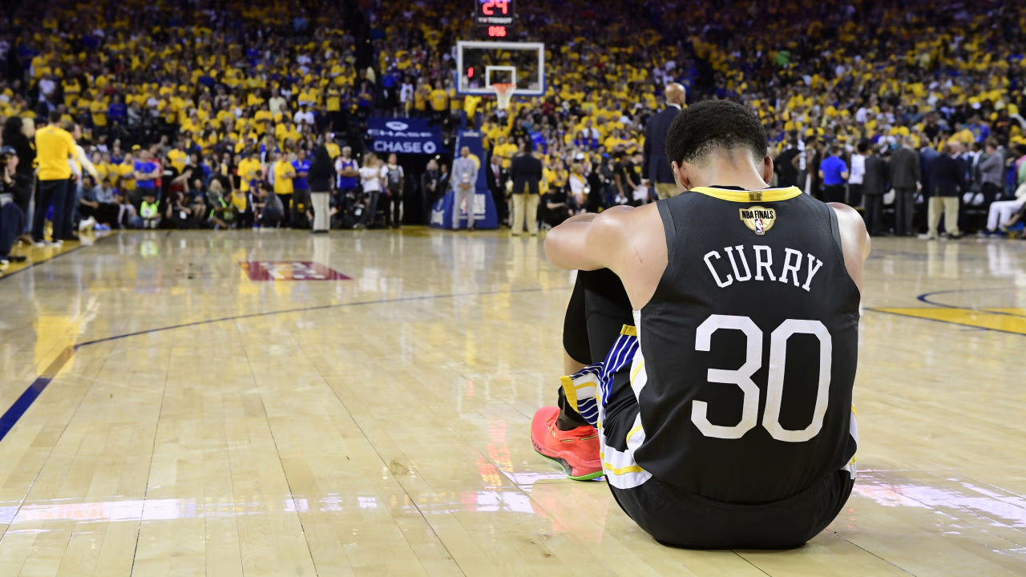
When the Game Is on the Line:
A Statistical Analysis of NBA Clutch Performance
2024–25 NBA Regular Season • Data Source: NBA.com
1) Introduction
2) What is “Clutch”?
3) Methodology
3.1) Dataset
4) Research Questions
5) RQ1 Plots
6) RQ2 Plots
7) RQ3 Plots
8) Conclusion
9) Limitations
Contents
Notes:
“Hi everyone. This presentation looks at NBA clutch performance in the 2024–25 regular season. In basketball, people often describe teams as clutch, but that idea is usually based on reputation or memorable moments, so, we wanted to study it statistically using team level data.

Slide 2
01
Introduction
Motivation
In basketball, nothing matters more than what happens when the game is on the line. Regular season records reveal a team's overall quality but they may not capture how a team responds when every possession is critical.
This project finds whether clutch performance is simply a reflection of overall team quality or whether it is a distinct, measurable trait.
The Approach
The Dataset
Compare team level clutch and regular season (non-clutch) performance to test whether late-game success reflects overall team quality or distinct performance patterns.
The dataset includes all 30 NBA teams from the 2024–25 regular season and combines multiple team-level tables from NBA.com to support comparisons between regular season and clutch play.
Notes:
“We are big NBA fans. What interested us about this topic is to see if overall team quality correlates to high-pressure performance. Over a full season, a team’s record tells us how good they are in general, but close late-game situations can feel very different from normal game flow. In clutch moments, a few metrics become more valuable. That makes clutch performance an interesting question statistically: are the teams that succeed late simply the best teams overall, or do some teams perform differently when the pressure increases? This project is built around that idea. Instead of treating clutch play as just a narrative, we analyze it as a measurable team-level phenomenon and look for patterns that help explain it.”

Slide 3
02
What is Clutch?
NBA Official Definition
"Clutch" = Final 5 minutes of the 4th quarter or overtime, when the score is within 5 points
5
±5
~37
24–46
minutes
points
games/team
game range
Time window
before final buzzer
Maximum score
difference to qualify
Average clutch games
per team in 2024–25
Min–Max clutch games
across all 30 teams
Why Clutch Stats Matter
Clutch situations represent the highest-pressure moments in basketball. A team with a dominant regular-season record may still struggle when every possession is critical. Analyzing clutch performance separately from overall performance reveals hidden strengths and weaknesses that standard box scores cannot capture.
Notes:
That definition matters because it turns a common basketball term into a measurable entity.. The slide also shows that clutch situations are not rare edge cases. On average, teams played around 37 clutch games during the 2024–25 season, although the number ranged from 24 to 46 depending on the team. So this gives us a meaningful amount of data rather than just a few isolated moments.

Slide 4
03
Methodology
1
Data Collection
2
Data Cleaning
3
Merging
4
Analysis
Used nba_api Python library to pull 2024–25 Regular Season data directly from NBA.com.
Three source datasets were used for the analysis: Clutch Traditional statistics, Clutch Four Factors statistics, and Regular-Season Traditional statistics.
After collection, relevant columns were selected from each file, unnecessary fields were removed, team names were standardized.
variables were renamed for clarity using clutch_ and reg_ prefixes.
Inner join: The three cleaned datasets were merged by team name to create one final team-level dataset containing regular-season and clutch statistics for all 30 NBA teams.
Final dataset:
30 teams × 33 columns → nba_clutch_merged.csv
Correlation analysis across 11 clutch metrics.
All visualizations produced in matplotlib:
• Scatter plots
• Bar charts
• Heatmap
• Slope charts
• Dumbbell plot
• Dot plots
Tools: Python 3 • pandas • matplotlib • nba_api • Season: 2024–25 Regular Season
Notes:
“On this slide, I summarize the full workflow used in the project. First, for data collection, I used the nba_api Python library, which is a Python wrapper that lets you access NBA.com stats endpoints programmatically instead of copying tables manually from the website. I used it to pull three team-level datasets: Clutch Traditional, Clutch Four Factors, and Regular-Season Traditional statistics. Once the data was collected, it was loaded into pandas DataFrames, which are table-like data structures in Python used for cleaning, transforming, merging, and analyzing data. During cleaning, I kept only the columns relevant to the research questions and removed fields like ranking columns, identifiers such as TEAM_ID, and unused raw or opponent-based statistics. The Four Factors dataset specifically included effective field goal percentage, turnover percentage, offensive rebounding percentage, and free-throw rate. After cleaning, I merged the datasets using an inner join on team name, producing one final team-level dataset for all 30 teams. Finally, I used correlation analysis and visualizations. A correlation analysis measures how strongly two variables move together, so it helped identify which clutch metrics were most positively or negatively associated with clutch success.”

Slide 5
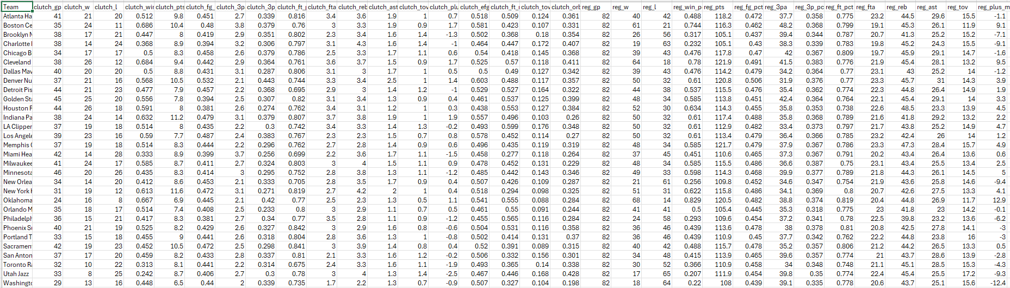
3.1
Dataset
Final merged dataset used for visualization
Notes:
“This slide shows the final merged dataset that was used for the analysis and visualizations. Each row represents one NBA team, so the final file contains all 30 teams from the 2024–25 regular season. The columns combine clutch metrics, regular-season metrics, and clutch four-factor variables into a single table. That means the dataset includes measures such as clutch win percentage, clutch shooting efficiency, turnover-related variables, free-throw metrics, and the corresponding regular-season statistics for comparison. Structuring the data this way made it possible to answer all three research questions using one consistent dataset.

Slide 6
04
Research Questions
RQ1
"Are the NBA's best regular-season teams also the most successful teams in clutch situations?"
Plots:
Plot 1: Scatter
Plot 2: Bar Chart
RQ2
"Which team-level factors most strongly explain clutch success: shooting efficiency, turnovers, rebounding, or free-throw generation?"
Plots:
Plot 1: Correlation Heatmap
Plot 2: Scatter
Plot 3: Quadrant
Plot 4: Dot Plot
RQ3
"How does shooting efficiency change from the regular season to clutch situations for the top 10 clutch teams?"
Plots:
Plot 1: Slope Chart
Plot 2: Dumbbell Plot
Plot 3: Slope Chart
Notes:
This slide summarizes the three research questions. The first question asks whether the NBA’s best regular-season teams are also the most successful teams in clutch situations. That helps establish whether clutch success is mostly an extension of overall team quality. The second question looks deeper and asks which team-level factors most strongly explain clutch success, with a focus on variables like shooting efficiency, turnovers, rebounding, and free-throw generation. This is where the analysis becomes more explanatory rather than just comparative. The third question shifts to regular-season versus clutch shooting efficiency among the top clutch teams, asking whether these teams become more or less efficient under pressure. Together, the three questions move from broad comparison, to identifying important factors, to examining how performance changes specifically in clutch situations.

Slide 7
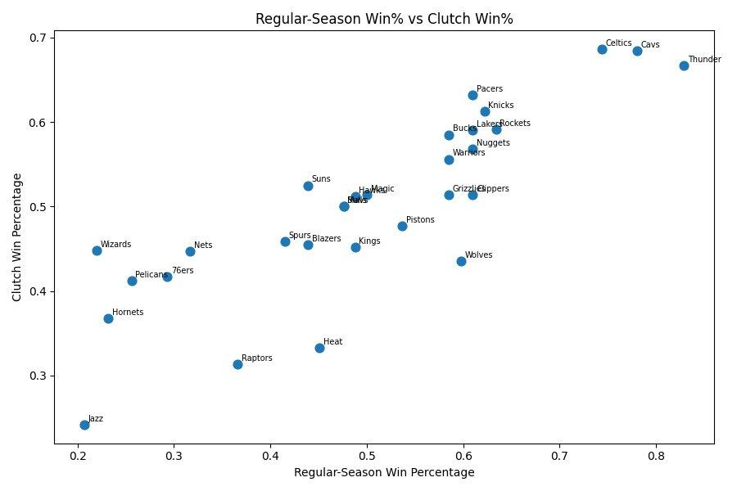
RQ1
Regular-Season Win% vs Clutch Win% [Plot 1 of 2]

Slide 8
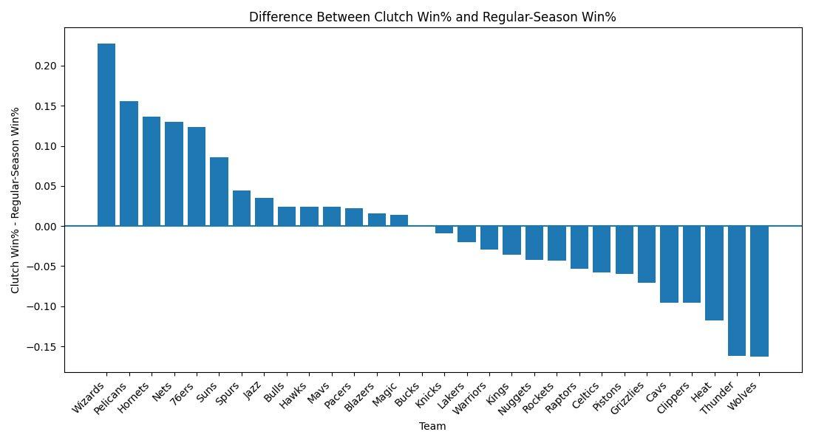
RQ1
Clutch Win% Minus Regular-Season Win%

Slide 9
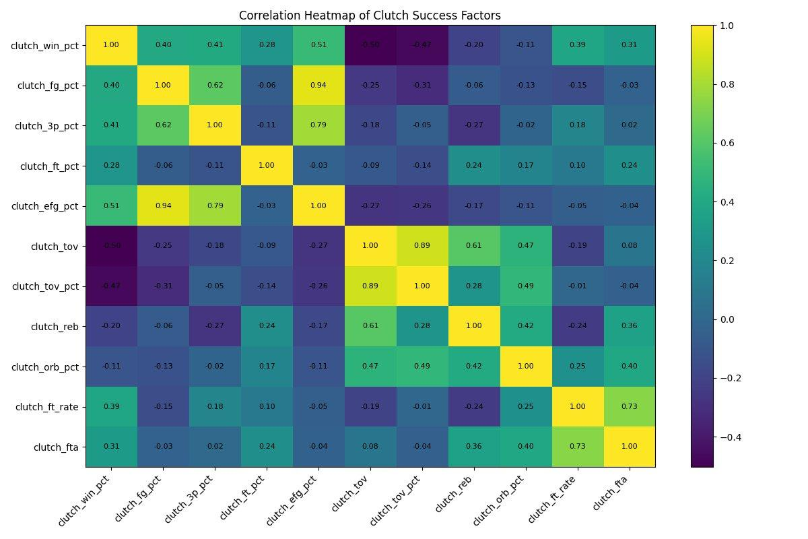
RQ2
Correlation Heatmap of Clutch Success Factors
Correlation Summary
Strongest POSITIVE correlates with clutch_win_pct: clutch_efg_pct r = +0.51 clutch_3p_pct r = +0.41 clutch_fg_pct r = +0.40 clutch_ft_rate r = +0.39 clutch_fta r = +0.31 Strongest NEGATIVE correlates with clutch_win_pct: clutch_tov r = −0.50 clutch_tov_pct r = −0.47 clutch_reb r = −0.20 clutch_orb_pct r = −0.11 Shooting efficiency and ball security dominate.
Rebounding has minimal impact.
Notes:
This is a Pearson correlation matrix that shows how strongly every pair of clutch-time statistics is related to each other.
Strongest POSITIVE relationships with clutch win percentage
clutch_efg_pct (effective field-goal %) → r = +0.51 ← strongest driver
clutch_3p_pct (three-point %) → r = +0.41
clutch_fg_pct (field-goal %) → r = +0.40
clutch_ft_rate (free-throw rate) → r = +0.39
clutch_fta (free-throw attempts) → r = +0.31
Translation: Shooting efficiency (especially effective Field Goal% and 3-point shooting) is the single biggest statistical predictor of winning close games.
Strongest NEGATIVE relationships with clutch win percentage
These are the factors that hurt teams in clutch moments:
clutch_tov (turnovers) turnovers mean ball lost by steal or a bad pass → r = -0.50 ← strongest killer
clutch_tov_pct (turnover rate) → r = -0.47
clutch_reb (rebounds) → r = -0.20
clutch_orb_pct (offensive rebound %) → r = -0.11
Translation: Ball security matters a lot. Every extra turnover (Ball lost) in clutch time is heavily punished. Rebounding, surprisingly, has almost no relationship with clutch success.
clutch_win_pct: Team’s win percentage specifically in clutch situations (the main outcome we’re trying to explain).
clutch_fg_pct: Field-goal percentage (all shots) during clutch time.
clutch_3p_pct: Three-point shooting percentage in clutch moments.
clutch_ft_pct: Free-throw percentage made in clutch situations.
clutch_efg_pct: Effective field-goal percentage in clutch time (gives extra credit to 3-pointers; strongest positive driver of wins).
clutch_tov: Raw total turnovers committed during clutch play (strongest negative factor).
clutch_tov_pct: Turnover rate (turnovers per possession) in clutch time.
clutch_reb: Total rebounds grabbed in clutch situations.
clutch_orb_pct: Offensive rebound percentage in clutch play.
clutch_ft_rate: Free-throw rate (free throws attempted per field-goal attempt) in clutch time.
clutch_fta: Total free-throw attempts in clutch situations.

Slide 10
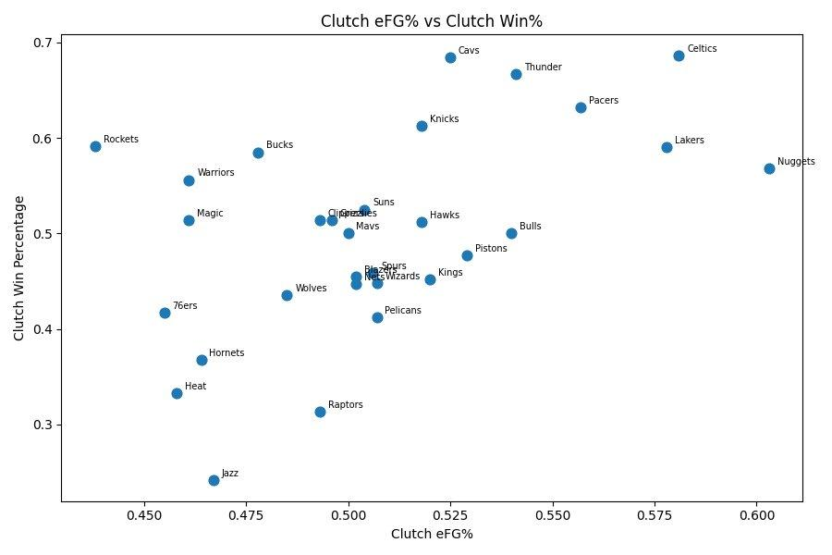
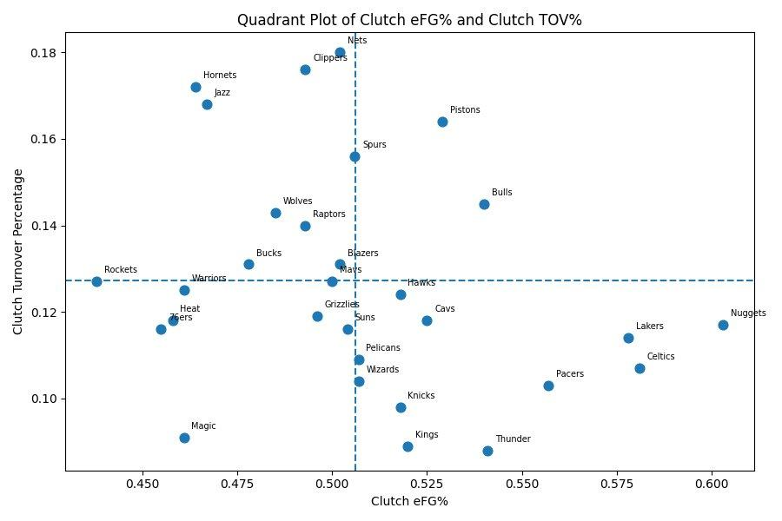
RQ2
Clutch eFG% vs Win% & eFG% vs TOV% Quadrant
Plot 2: Higher eFG% → higher clutch win%. Strongest single positive factor (r = +0.51).
Plot 3: Teams in top-right (high eFG%, low TOV%) = best clutch profile. Thunder, Celtics, Pacers lead.
Notes:
Left Plot: Clutch eFG% vs Clutch Win%
X-axis: Clutch Effective Field Goal % (scoring efficiency in the last 5 min of close games; 3s count extra).
Y-axis: Clutch Win Percentage.
What it shows: Clear upward trend ->>> teams that shoot more efficiently in clutch time win way more close games.
Standout teams:
Top-right (elite): Celtics, Thunder, Cavs, Pacers (high efficiency + high win %)
Bottom-left (struggling): Jazz, Heat, Raptors, Magic
Takeaway: Making shots (especially 3s) at a high effective rate is the biggest reason teams win in crunch time.
Right Plot: Quadrant Plot of Clutch eFG% vs Clutch TOV%
X-axis: Same Clutch eFG% (right = better).
Y-axis: Clutch Turnover Percentage (higher = worse).
Dashed lines = league averages.
The four quadrants show the combined effect of the two biggest factors:
Best quadrant (high eFG% + low TOV%): efficient shooting + excellent ball security.
Worst quadrant (low eFG% + high TOV%): Poor shooting + careless with the ball.
Standout teams: Thunder, Celtics, Pacers lead the best quadrant ->> they do both things at an elite level.

Slide 11
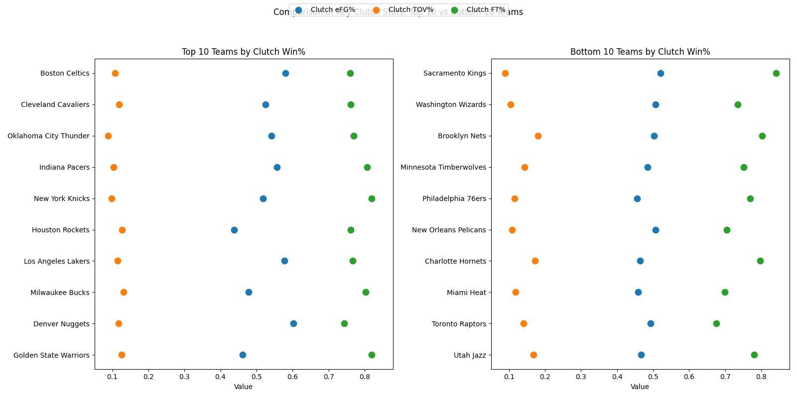
RQ2
Top 10 vs Bottom 10 Teams by Clutch Win%
Notes:
Clutch FT % ->>Free-throw percentage made in clutch situations.
Clutch eFG%->> effective field goals in clutch situations
Clutch TOV -> turnover percentage
The strongest clutch teams combine high effective field-goal percentage (efficient scoring) with low turnover percentage (protecting the ball in crunch time).
The weakest clutch teams tend to struggle with one or both of those (lower eFG% and/or more turnovers).
Free-throw percentage (green) is generally high across the board and does not separate the top and bottom groups as clearly.

Slide 12
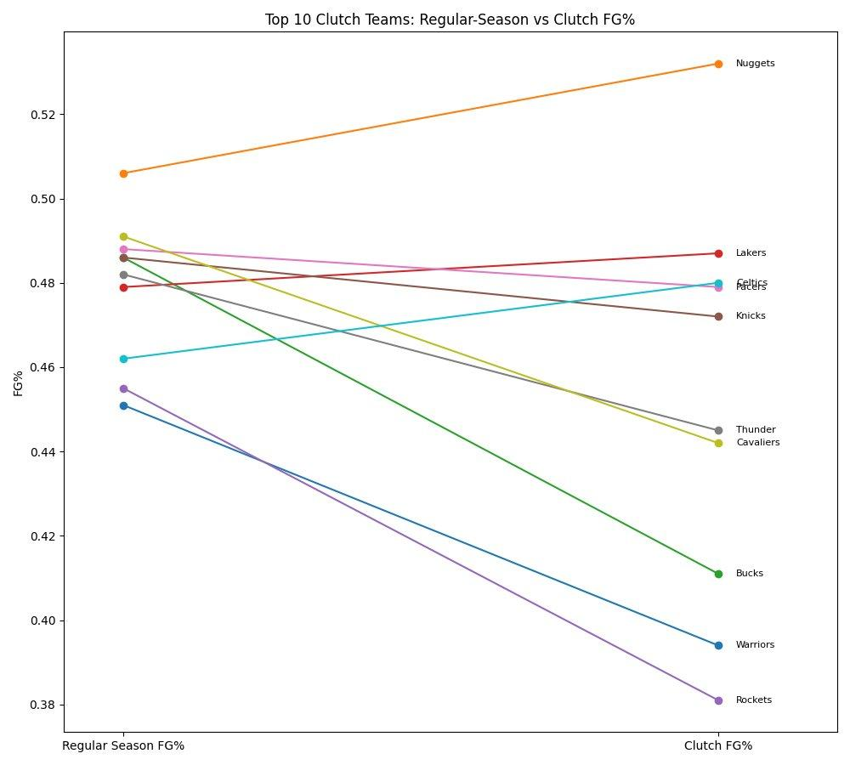
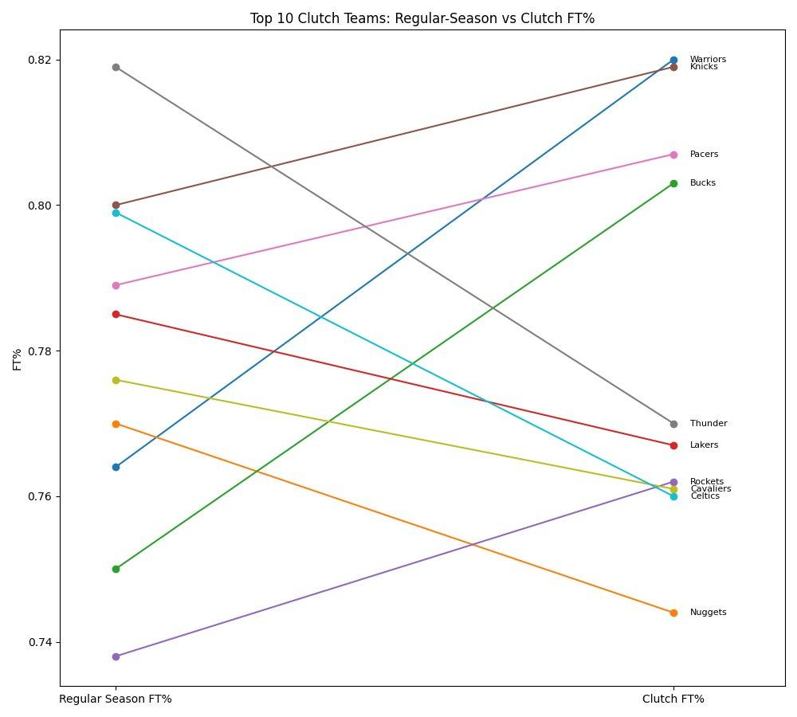
RQ3
Reg-Season vs Clutch FG% & FT% — Top 10 Clutch Teams
FG%: Most teams decline in clutch. Exception: Nuggets improve 0.506 → 0.531. Warriors & Rockets drop sharply.
FT%: Warriors & Knicks improve to ~0.82. Thunder drop from 0.819 → 0.770 under pressure. High variability.

Slide 13
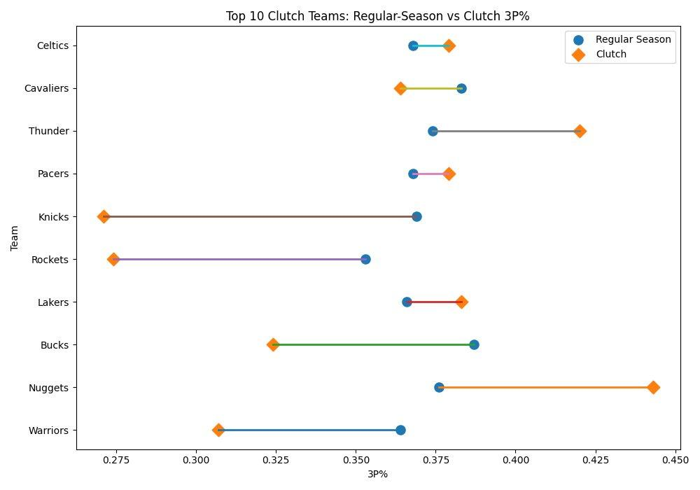
RQ3
Regular-Season vs Clutch 3P% — Top 10 Clutch Teams
3P% Shifts
Most volatile metric Three-point shooting fluctuates the most between regular season and clutch play. Big CLUTCH improvers Nuggets +0.07 (0.370 → 0.443) Thunder +0.06 (0.362 → 0.420) Lakers +0.02 (0.361 → 0.383) Big CLUTCH decliners Knicks −0.11 (0.381 → 0.271) Rockets −0.08 (0.355 → 0.274) Warriors −0.05 (0.360 → 0.307) Takeaway: Clutch 3P% reliability separates consistently elite clutch teams from those that are inconsistent under pressure.

Slide 14
Conclusion
01
RQ1
Regular-season record is a rough — not reliable — clutch predictor
Positive correlation exists (teams like Celtics & Thunder dominate both), but Wizards (+0.228) and Wolves (−0.163) show the relationship breaks down significantly at the extremes.
02
RQ2
Clutch eFG% is the single strongest explanatory factor (r = +0.51)
Efficient shooting under pressure drives clutch wins more than any other metric. eFG% captures both 2-point and 3-point efficiency in a single value and it matters most when the game is closest.
03
RQ2
Turnover control is the strongest negative factor (r = −0.50)
Clutch turnovers and clutch TOV% are equally important as shooting efficiency, just in the opposite direction. Teams that give the ball away in the final five minutes hand opponents free scoring opportunities.
04
RQ3
Top clutch teams experience real shooting shifts under pressure
FG% dips for most. 3P% is highly volatile (Knicks −0.11; Nuggets +0.07). FT% can go either direction. Elite clutch teams are distinguished by their ability to maintain efficiency despite the pressure.
NBA Clutch Performance Analysis • 2024–25 Season • Data: NBA.com

Slide 15
09
Limitations
Team-Level Only
Single Season
Clutch Definition is Fixed
All analysis is at the team level. Player-level contributions, lineup combinations, and individual performance in clutch moments are not captured. A star player's presence or absence could explain outliers.
Data covers only the 2024–25 Regular Season. Findings may not generalize across multiple seasons — a team's clutch performance can vary year-to-year based on roster changes and coaching.
The NBA's definition (last 5 min, ±5 pts) is specific. A wider or narrower definition would yield different datasets and potentially different conclusions.
Small Sample Size Per Team
Correlation ≠ Causation
No Opponent Adjustment
Clutch game count ranges from 24 to 46 per team (~37 avg). This is a relatively small sample for statistical inference — some team-level patterns may reflect noise rather than true performance differences.
The correlation analysis identifies associations, not causal relationships. We cannot conclude that high eFG% causes clutch wins — both may be driven by underlying team quality or opponent strength.
Stats are not adjusted for opponent strength in clutch situations. A team facing weak opponents in clutch moments may inflate its clutch win% without being a genuinely elite clutch team.

